Slide 1
COMPETITIVE ANALYSIS USING LLMS & DATA SCIENCE
By – Kedar Kenjalkar (TE)

Slide 2
ASPECTS OF THE PROJECT -
This project was made for performing competitive market study applications.
This progresses through various stages of the development life cycle.
Intent of the project –
Working with NSE listed market data
Use and study LLMs for sentiment analysis
Integrate different APIs for response and streaming control
Workflow management frameworks
Studying OS based deployment and configuration

Slide 3
PART 1 – DATA WAREHOUSING MARKET DATA
Made use of yfinance API for fetching data from server.
The data was for each listed company name in the input file of NSE listed companies.
The workflow is as follows –
1. Run the bash file for setup
2. The bash files 3 scripts inside it – create_tables, extract_data_all_time and
bulk_upload.
3. This sets up the entire data in the Supabase tables.
Frameworks and libraries – psycopg, supabase client, yfinance, httpx, requests, xml parser function (self written)

Slide 4
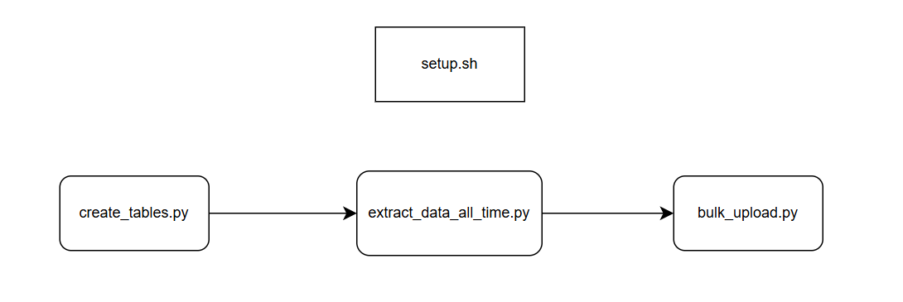
setup.sh shell file for setup flowchart

Slide 5
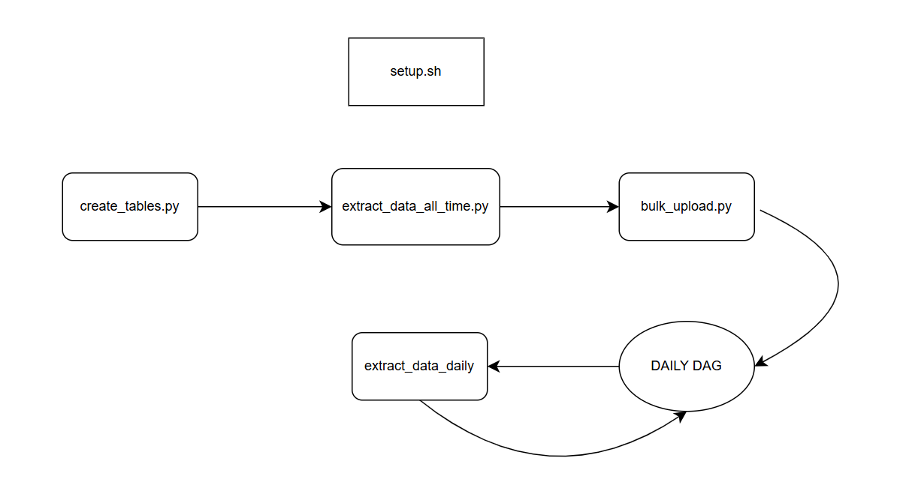
DAILY DATA EXTRACTION FEATURE
For updating the EOD price for each ticker available a DAG is scheduled for everyday using Apache Airflow.
The workflow file sits under the dags folder inside the airflow directory for scheduled scripts.

Slide 6
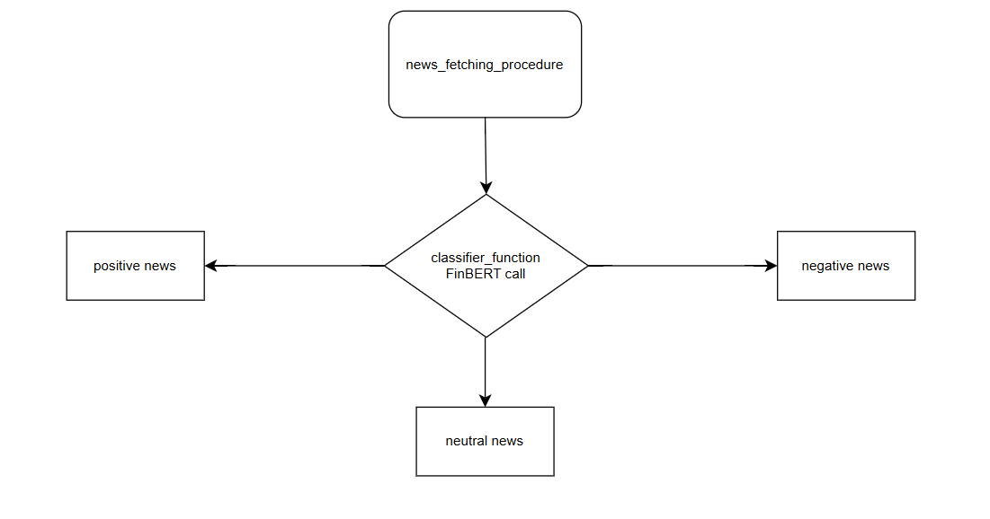
PART 2 – SENTIMENT ANALYSIS FOR ANY STOCK
Sentiment classification performed using FinBERT. Classified headlines in terms of positive, negative and neutral.
Use of yfinance news and Gnews python package to perform sentiment analysis on “n” different news headlines.

Slide 7
PART 3 - Autogen Agentic Workflows
Created different AssistantAgent objects for performing yfinance market research and sentiment analysis tasks.
UserProxy agent for accepting prompt and communicating to the GroupChat of multiple made agent.
Iteration 1 was done using GroupChatManager
Later used MagenticOneOchestrator agent for understanding prompts, making choice of the right FunctionTool to use in achieving the ultimate goal.
All responses Pydantic or JSON type.

Slide 8
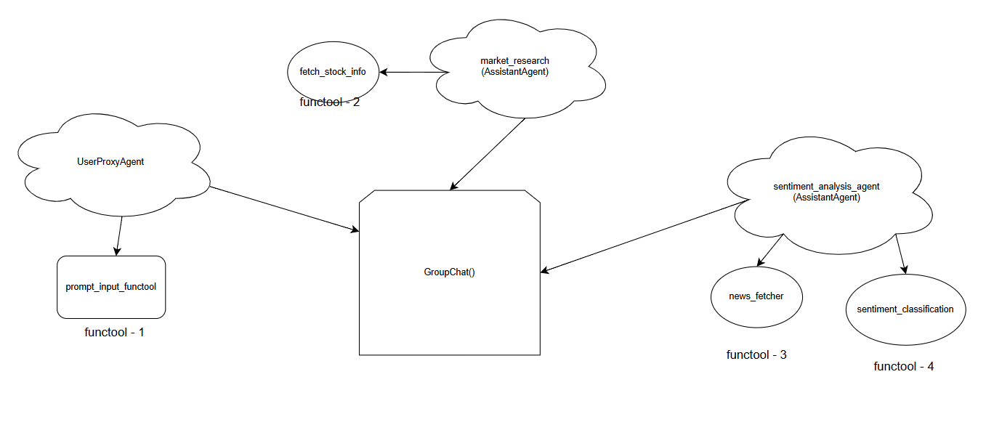

Slide 9
PART 4 – LangGraph cyclic graphs
Implementation using LangGraph based nodes and edges for creating workflows.
Nodes in play –
1) prompt_input
2) prompt_analysis - *
3) sentiment_analysis_node
4) market_research_node
Added edges for connecting nodes for completing graph.

Slide 10
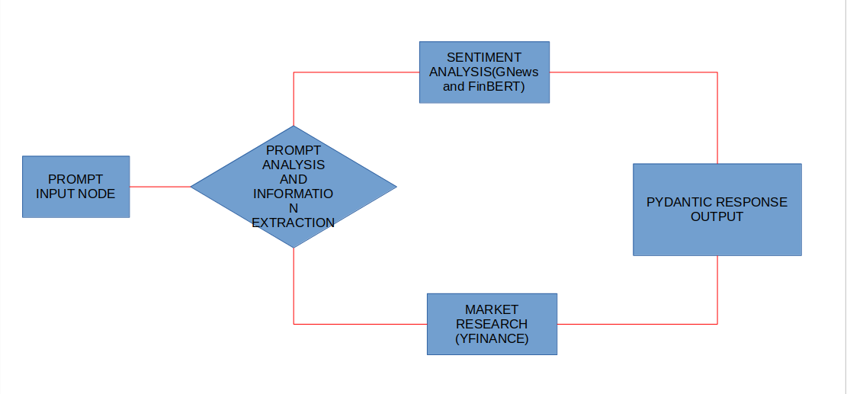

Slide 11
CURRENT WORK -
Implementing the same system using Anthropic - Model Context Protocol.
Consisting of MCP servers holding procedures as Tools.
MCP Clients will be used for processing request, Servers make the decision of executing which function procedures on the data that is provided or extracted based on Claude API.

Slide 12
YOU HAVE REACHED THE END :(
READY FOR YOUR QUESTIONS.

